Slide 1
Chapter 8.4
Failure Mode and Effects Analysis (FMEA)
Everything that can fail, shall fail!
Notes:
Failure Mode and Effects Analysis (FMEA) is an important reliability design tool that has been gaining in popularity.

Slide 2
Failure Mode and Effects Analysis
Definition
A bottoms-up, iterative approach for analyzing a design of a product or process in order to determine
  what could wrong
  how badly it might go wrong
  and what needs to be done to prevent it
FMEA
Notes:
It is a systematic bottoms-up approach for identifying failure modes, their causes and effects, and their elimination during conceptual design.

Slide 3
Alternate Definition
Failure Mode and Effects Analysis (FMEA for short) is a systematic way to identify and evaluate the potential failures of a product or process. It provides a formal process for eliminating or mitigating the risks of a failure. It is an on-going process that documents and tracking problems and changes through the product development phase.
FMEA
Notes:
A formal definition.

Slide 4
Yet Another Definition
A formal, structured process which is applied in developing something new to assure that as many potential problems as are reasonably possible to predict have been considered, analyzed, and their causes remedied before the item under development reaches the hands of the end user.
Applicable to
  product development
  idea development
  organization development
  process development
  software development
FMEA
Notes:
FMEA can be applied to either a product or a process.

Slide 5
Objective
…to identify early in the product or process design all manner of failures so they can be eliminated or their impact reduced through redesign at the earliest possible time.
FMEA
Notes:
The proper use of this technique allows for the early identification of reliability problem areas.

Slide 6
Failure Mode, Effects, and Criticality Analysis (FMECA)
What’s a FMECA?
FMEA
Notes:
A more expanded version of FMEA includes a determination of the criticality or severity of a particular failure mode.

Slide 7
FMEA and FMECA promotes…
An objective and detailed evaluation of a product or process leading to
a critical analysis of failure modes and processes
with a corresponding assignment of responsibility
FMEA

Slide 8
Benefits
Improved product or process functionality
Verify design integrity
Provide rationale for change
Reduced warranty and replacement costs
Reduction in day-to-day manufacturing problems and costs
Improved safety of products and processes
FMEA
Notes:
The FMEA process provides for a critical look at the design by a number of knowledgeable people. Collectively, this study group is often able to identify a number of areas for improvement.

Slide 9
Background
1949 - US military
  Military Procedure MIL-P-1629 (procedures for performing a FMEA
  used as reliability evaluation technique
1960’s - Used in the by the aerospace industry and NASA during the Apollo program
1988 – ISO 9000 business management standards
  required organizations to develop quality systems
  QS 9000 developed by Chrysler, Ford and GM
  compliant automotive suppliers shall utilize FMEA
1993 – Automotive Industry Action Group (AIAG) and American Society for Quality Control (ASQC)
  Society of Automotive Engineers (SAE) procedure SAE J-1739
  Provides general guidelines for performing a FMEA
FMEA
Notes:
Some history.

Slide 10
Basic Concept
begin at the lowest level of the system
identify potential failure modes
assess their effect and causes
prioritize based upon effect
through redesign
  eliminate the failure
  or mitigate its effect
FMEA
Notes:
FMEA is a bottoms-up approach for identifying failures modes and their causes, prioritizing their impacts, and then seeking ways to either eliminate or reduce their occurrence.

Slide 11
Basic Concept - Example
component – computer monitor
part – capacitor
identify two failure modes
  fail “open”
    effect are wavy lines appearing on monitor
  fail “short”
    effect is the monitor going blank
prioritize – short more critical than open
determine cause of failure mode
  underrated capacitor
investigate ways of eliminating failure
  resize capacitor
FMEA
Notes:
A simple example of the overall approach.

Slide 12
More Basic Concepts
Team effort
  5 to 7 members
  team lead engineer
  representation from design, assembly, manufacturing, materials, quality, and suppliers
Usually done near the end of the product or process design phase
Analysis should continue throughout the product development cycle
Should be a living document that is updated as design changes and new information becomes available
FMEA
Notes:
Teams are formed to conduct a FMEA study. The team is responsible for conducting and documenting the analysis and then making recommendations for implementation.

Slide 13
Product versus Process
Product or Design FMEA.
  What could go wrong with a product while in service as a result of a weakness in design.
  Product design deficiencies
Process FMEA.
  What could go wrong with a product during manufacture or while in service as a result of non-compliance to specification or design.
  Manufacturing or assembly deficiencies
  Focus on process failures and how they cause bad quality products to be produced
FMEA
Notes:
The technique can be applied to a process as well as a product. For example, a FMEA may be conducted to evaluate a manufacturing process for a new product.

Slide 14
Product (Design) FMEA
Assumes manufacturing and assembly will produce to design specifications.
Does not need to include failure modes resulting from manufacturing and assembly.
Does not rely on process controls to overcome design weaknesses.
Does consider technical and physical limitations of the manufacturing and assembly process.
FMEA
Notes:
A product FMEA will usually take the production process as a given. That is, it will assume that manufacturing will produce to specifications.

Slide 15
Process FMEA
Assumes the product meets the intent of the design.
Does not need to include failure modes originating from the design.
  assumes a design FMEA covers these failures
Usually originates from a flow chart of the process
FMEA
Notes:
A process FMEA will not normally address product design failure modes.

Slide 16
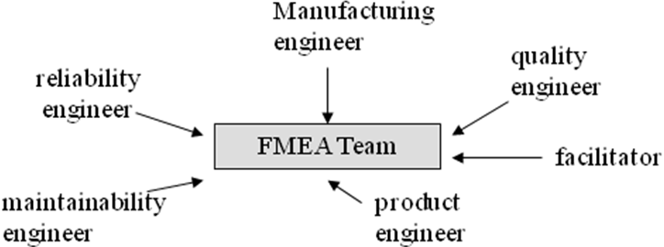
The FMEA Team
FMEA
Notes:
Typical team members for a process FMEA. The facilitator is knowledgeable in conducting a FMEA but may not have in-depth process or product knowledge.

Slide 17
Affected Functional Areas
design
materials
manufacturing
assembly
packaging
shipping
service
recycling
quality
reliability
vendors
customers.
  downstream engineering functions
  downstream manufacturing functions
  end users
  service functions,
  recycling or reuse functions
FMEA
Notes:
The scope of an FMEA may be quite large and encompass the entire production environment.

Slide 18

Methodology
System or Process Definition
Determination of Failure Modes
Determination of Cause
Assessment of Effect
Estimation of Probability of Occurrence (O)
Estimation of Detecting a Defect (D)
Classification of Severity (S)
Computation of Criticality (Risk Priority Number)
  RPN = (S) x (O) x (D)
Determination of Corrective Action
A worker looking
for the 9 easy steps
to complete a FMECA
FMEA
Notes:
Nine easy steps to conducting a FMEA. Step 5, 6, and 7 requires some level of quantification in to prioritize failure modes in step 8.

Slide 19
FMEA Flow Diagram
2. Identify
Failure
Modes
5. Estimate
occurrence
8. Compute
RPN
Prioritize
1. Define
Process
3.Establish
Cause
6. Determine
Detection
4. Assess
Effect
7. Assign
Severity
9. Take
Corrective
Action
FMEA
Notes:
The nine easy steps shown graphically.

Slide 20
FMEA Worksheet
Component or Process | Failure Mode | Failure Cause | Failure Effect | Correction
CRT Picture tube | Bad pixels | excessive heat | picture degraded | larger fan
CRT Picture tube | Bad pixels | dropping or bumping | picture degraded | improve packaging
Cabling to unit | broken or frayed | fatigue, heat | will not conduct | higher grade wire
Cabling to unit | internal short | heat, brittle insulation | shock, damage to unit | higher grade wire
FMEA
Notes:
Documentation of the FMEA may be accomplished through the use of specialized software or through the use of a spreadsheet.

Slide 21
Step 1. Product / Process Definition
Describe product and its design or the process and its operations
Identify the purpose or function of each component or each operation
Use functional diagrams, design drawings, flow charts and other graphical techniques
Include each significant element that is likely to fail
FMEA
Notes:
Begin by defining the product and its design or the process and its operations.

Slide 22
Step 2. Determination of Failure Modes
A failure mode is the manner in which a process could potentially fail to meet the process requirement or the design intent.
It is a statement of non-performance or a non-conformance to a design specification.
Questions to be answered include:
  how can the process/part fail to meet specs
  regardless of the specs, what would customer find objectionable?
FMEA
Notes:
Each failure mode would be an entry (row) on the spreadsheet.

Slide 23
Examples of Failure Modes
ruptures
fractures or cracks
short or open circuits
deformation
contamination
loss of power
buckling
FMEA
Notes:
Failure modes may initially be determined through a brainstorming session by the FMEA team.

Slide 24
Step 3. Determination of Cause
Identify how the failure could occur
Find the root cause!
State in terms of something that can be corrected
Attempt to establish an exhaustive list
Further analysis may be required to isolate cause (e.g. a design of experiments)
FMEA
Notes:
Through knowledge of the product and its use or the process and its operations or through engineering analysis, failure causes are identified.

Slide 25
Potential Failure Mode Causes
Abnormal stress. usually external or environmental, could be an internal power surge
Mechanical stress. Continued vibration may loosen fittings, for example.
Contamination. Dirt can cause electrical failure.
Evaporation. Filaments age because of filament molecules evaporating.
Fatigue. Physical changes in material may result in fracture.
Friction. This is a common cause of failures in belts, gears, and machinery
Temperature cycling. Repeated expansion and contraction
Aging /wearout. not a prime cause, but prolonged exposure to other causes.
Substandard or defective parts. poor quality control during manufacture.
Poor workmanship. Lack of training or proper motivation, fatigue
Operator-or maintenance-induced error. human error.
Corrosion. This is chemical change that weakens material.
FMEA

Slide 26
Analysis of Failure Mode Causes
Failure mode | Category | Cause | Failure mechanism | Possible corrective action
Capacitor short | Electrical | High voltage | Dielectric breakdown | Derating
Failure of metal contacts | Chemical | Humid and salty atmosphere | Corrosion | Use of a protective casing
Connector fractures | Mechanical | Excessive vibration | Fatigue | Redesign of mountings
FMEA

Slide 27
Step 4. Assessment of Effect
Assess the effect of the failure mode on the customer
Customer may be next operation, subsequent operations, the end-user, or the seller
Answer the question what might the customer observe or experience.
FMEA
Notes:
Not all failures have the same effect particularly upon the customer. The intent is to find the failures that are most significant and important to the customer. A blemish on the cabinet housing of a stereo player is not as critical as a poor electrical connection.

Slide 28
Failure Mechanisms, Modes, And Effects
Failure Mechanism produces→ | Failure Mode which causes → | Failure Effect
corrosion | failure in tank wall seam | tank rupture
manufacturing defect in casing | leaking battery | flashlight failure to light
prolonged excessive vibration and fatigue | break in a motor mount | loss of engine power and excessive noise
friction and excessive wear | drive belt break | shut down of production line
contamination (dust and dirt) | loss of contact | circuit board failure
evaporation | filament breaks | light bulb burns out
prolonged low temperatures | brittle seals | leakage in hydraulic system
FMEA

Slide 29
Step 5. Estimation of Probability of Occurrence (O)
Occurrence refers to how frequently the specific failure mode will be observed.
Estimated on a scale from “1” to “10”
Statistical analysis may be used if historical data is available
Otherwise estimated subjectively
FMEA
Notes:
To prioritize failures, estimates of their (relative) probabilities of occurrences must be made.

Slide 30
Step 6. Estimation of Detecting a Defect (D)
The probability that the current process controls will detect the failure mode before the part or component leaves the process.
Assume failure has occurred, and then assess the likelihood that the product will continue to its next stage.
Rank on scale of “1” (almost certain to detect) to “10” (no way of detecting failure)
FMEA
Notes:
Some failures will be detected by processes already in place such as quality control and inspection. If a failure is detected before the product gets to the customer, then its significance is not as great.

Slide 31
Step 7. Classification of Severity (S)
An assessment of the seriousness of the effect of the failure mode on the customer
Estimated on a scale of “1” to “10.”
Assessed against
  safety; i.e. injury or death
  extent of damage
  or amount of economic loss
FMEA
Notes:
The severity of the failure if observed by the customer is determined.

Slide 32
Step 8. Computation of Criticality
Risk Priority Number (RPN)
Product of Severity (S), Probability of Occurrence (O), and Detecting a Defect (D)
RPN = (S) x (O) x (D)
Range is 1 to 1000 with the higher the number, the more critical the failure mode.
Rank order RPN from highest to lowest
FMEA
Notes:
A risk priority number is just one way of ranking the various failure modes. Those failure modes with the highest scores should be addressed first.

Slide 33
Probability of Failure
Probability of Failure Mode | Possible failure rates | Probability | Ranking
Very high: failure is almost inevitable | ≥ 1 in 2 | .50 ≤ p ≤ 1.00 | 10
Very high | ≥ 1 in 3 | .33 ≤ p < .50 | 9
High: repeated failures | ≥ 1 in 8 | .125 ≤ p < .33 | 8
High | ≥1 in 20 | .05 ≤ p < .125 | 7
Moderate: occasional failures | ≥ 1 in 80 | .0125 ≤ p < .05 | 6
Moderate | ≥ 1 in 400 | .0025 ≤ p < .0125 | 5
Moderate: infrequent failures | ≥ 1 in 2000 | .0005 ≤ p < .0025 | 4
Low: relatively few failures | ≥ 1 in 15,000 | .0000667 ≤ p < .0005 | 3
Low | ≥ 1 in 150,000 | 6.7 x 10⁻⁶ ≤ p < 6.67 x 10⁻⁵ | 2
Remote: failure is unlikely | ≥ 1 in 1,500,000 | 6.7 x 10⁻⁷ ≤ p < 6.67 x 10⁻⁶ | 1
Adopted from FMEA Manual (Chrysler, Ford, General Motors Supplier Quality
Requirements Task Force)
FMEA

Slide 34
Likelihood of Detection
Detection | Criteria | Ranking
Almost impossible | No known way to detect failure mode | 10
Very remote | Very unlikely to detect failure mode | 9
Remote | Unlikely to detect failure mode | 8
Very Low | Very low chance to detect failure mode | 7
Low | Low chance to detect failure mode | 6
Moderate | Moderate chance to detect failure mode | 5
Moderately High | Moderately high chance to detect failure mode | 4
High | Likely to detect failure mode | 3
Very high | Very likely to detect failure mode | 2
Almost certain | Will almost certainly detect failure mode | 1
FMEA

Slide 35
Severity Rating
Severity | Criteria | Ranking
Hazardous-without warning | May endanger operator; noncompliance with regulations; affects the safe use of the product; failure will occur without warning. | 10
Hazardous-with warning | May endanger operator; noncompliance with regulations; affects the safe use of the product; failure will occur with warning. | 9
Very high | Process or product inoperable with loss of primary function; major disruption to the production line; product may have to be scrapped; customer very dissatisfied. | 8
High | Process or product operable but at reduced level of performance; minor disruption to production line; the product may have to be sorted and a portion (less than 100%) scrapped; customer dissatisfied | 7
Moderate | Process or product operable but comfort or convenience items inoperable; minor disruption to production line; a portion (less than 100%) of the product may have to be scrapped (no sorting); customer experience discomfort | 6
FMEA

Slide 36
Severity Rating
Severity | Criteria | Ranking
Low | Process or product operable but comfort or convenience at reduced level of performance; minor disruption to production line; a 100% of the product may have to be reworked; customer experiences some dissatisfaction | 5
Very low | Minor disruption to production line; product may have to be sorted and a portion (less than 100%) reworked; cosmetic (fit and finish) defect (nonconformance) noticed by most customers | 4
Minor | Minor disruption to production line; a portion of the product may have to be (less than 100%) reworked on-line but out-of-station; cosmetic (fit and finish) defect (nonconformance) noticed by average customer | 3
Very minor | Minor disruption to production line; a portion of the product may have to be (less than 100%) reworked on-line but in-station; cosmetic (fit and finish) defect (nonconformance) noticed by discriminating customers | 2
None | No effect | 1
FMEA

Slide 37
Step 9. Corrective Action
Removing the cause of the failure,
Decreasing the probability of occurrence, or
Increase the likelihood of detection, or
Reducing the severity of the failure.
FMEA
Notes:
There are four general steps that can be taken to mitigate a failure mode.

Slide 38
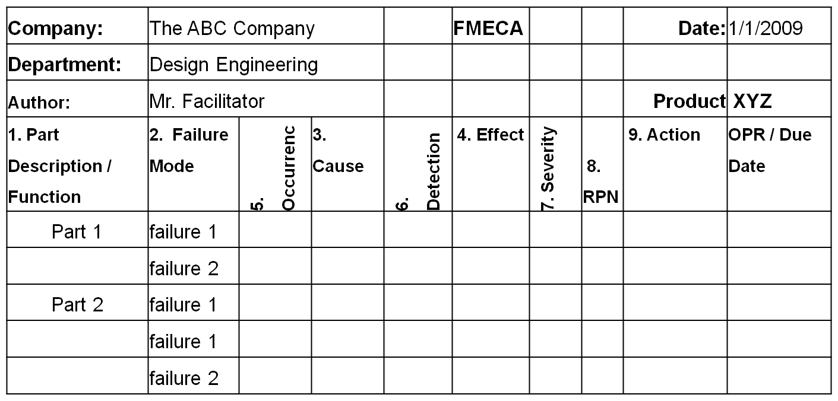
FMECA worksheet
FMEA

Slide 39
Related Concepts
Quality Functional Deployment (QFD)
  customer requirements
Total Quality Management (TQM)
Statistical Process Control (SPC)
  detection
Design of Experiments (DOE)
  root causes
Six Sigma
  process improvement
Fault Tree Analysis (FTA)
On-going Reliability Testing (ORT)
FMEA
Notes:
Other product design tools that are closely associated with a FMEA.

Slide 40
Difficulties in Implementation
Time and resource constraints
Lack of understanding of the purpose of FMEA
Lack of training
Lack of management commitment
      Dale and Shaw, 1990: “Failure Mode and Effects Analysis in the Motor Industry,” Quality and Reliability Engineering International.
FMEA
Notes:
A FMEA must have management support, be adequate resourced, and the team properly trained in its objectives and use.

Slide 41

Conclusion & Questions
What is a FMEA?

